Slide 1
Variables, Arguments, and Control Flow in Studio

Slide 2
Variables
What are variables?
Variables are containers that can hold multiple data entries (values) of the same data type.
For example, EmailAddress can be a variable that holds the value "rpadeveloper@uipath.com".
The value of a variable can change through external input, data manipulation or passing from one activity to another.
Why are they important?
Variables help us pass data from one activity to another. Advancing with any automation process would be hardly possible without using variables.

Slide 3
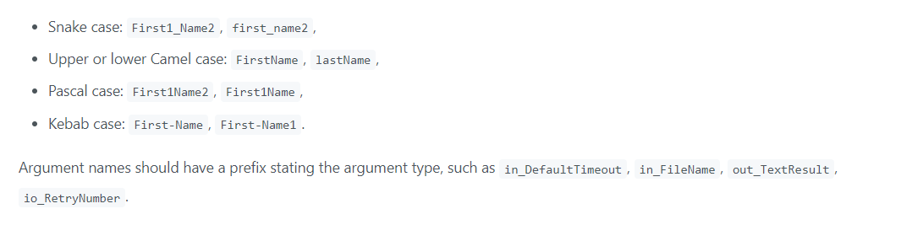
Naming Conventions
Meaningful names should be assigned to workflow files, activities, arguments, and variables in order to accurately describe their usage throughout the project.
Projects should have meaningful descriptions, as they are also displayed in the Orchestrator user interface and might help in multi-user environments.
To improve readability, variable and argument names should also align to a naming convention:

Slide 4
Variables Properties
Name
The variable's name is its unique ID and it defines the way it is displayed and used.
we recommend using PascalCase for variable names.
Type
It defines what kind of data can be stored in the variable. In UiPath, the type is declared when the variable is created, however there are some types that can accommodate different types of data.
Default Value
In general, variables have initial values that change throughout the process. For most variables, if no initial value is assigned when the variable is declared, there is a default rule that assigns a value.
Scope
The part of the workflow in which the variable can be used. Some variables can be global (used throughout the workflow), others local (used inside an activity).

Slide 5
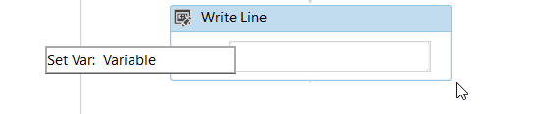
Creating Variables
From the Activities panel, drag an activity to the Designer panel. Right-click a field and select Create Variable from the context menu, or press Ctrl+K. The Set Var field is displayed.
Fill in the name and press Enter. The variable is created and visible in the field. Check its scope and type in the Variables panel.

Slide 6
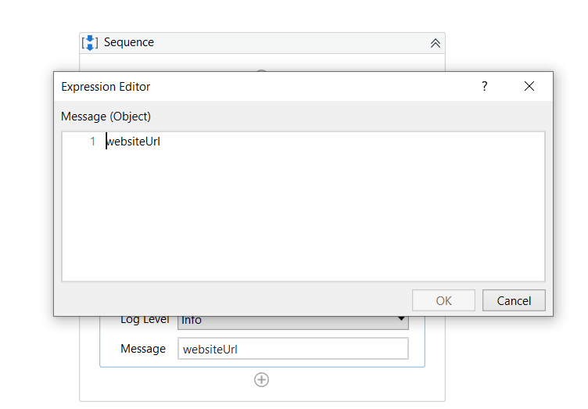
Creating Variables
From Expressions
Alternatively, variables can be created from expressions directly in an activity input field or the Expression Editor:
Select a part of the expression and press Ctrl+K. The Set Var field is displayed.
Fill in the name and press Enter. The variable is created. Check its scope and type in the Variables panel.

Slide 7
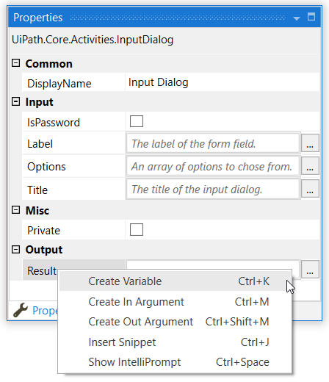
Creating Variables
From the Properties Panel
In the Properties panel of any activity, right-click a field that can be edited, and select Create Variable from the context menu, or press Ctrl+K. The Set Var field is displayed.
Fill in the name and press Enter. The variable is created and visible in the field. Check its scope and type in the Variables panel.

Slide 8
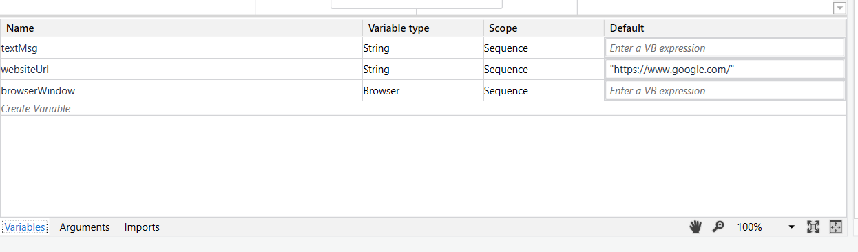
Creating Variables
From the Variables Panel
In the Designer panel, click Variables. The Variables panel is displayed.
Click the Create Variable line, and fill in the name. A new variable is created.
The default type of variables created this way is String.

Slide 9
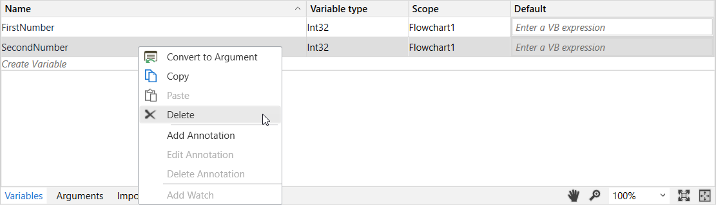
Removing Variables
To remove a variable, in the Variables panel, either right-click the variable and select Delete, or select the variable and press the Delete key

Slide 10
Types of Variables
Text Variables
True or False Variables
Number Variables
Array Variables
Date and Time Variables
Data Table Variables
GenericValue Variables

Slide 11
Invoke Workflow and Arguments
What is a workflow?
A workflow represents a small piece of automation that you can take and re-use in your projects. It is basically your canvas, the place where you design and work with all the UiPath Studio activities and it defines the flow of your automation. Hence the name, workflow.
UiPath Studio provides you with predefined workflow layouts to suit all the needs of a fast and reliable automation process.

Slide 12
The workflow layouts are:
Sequences
Flowcharts
State Machines
Global Exception Handler

Slide 13
Arguments
What is an argument?
Arguments are very similar to variables:
They store data dynamically
They have the same data types
They support the same methods and properties
The difference is that they pass data between workflows, and they have an additional property for this – the direction. Arguments have specific directions: In, Out, and In/Out. These tell the Robot where the information stored in them is supposed to go.

Slide 14
Creating Arguments
Why are they important?
Arguments are a key component when it comes to building more complex automations, where you need to store and use data between multiple workflows.
Argument names should be in upper CamelCase with a prefix stating the argument direction, such as in_DefaultTimeout, in_FileName, out_TextResult, io_RetryNumber

Slide 15

From the Body of an Activity
From the Activities panel, drag an activity to the Designer panel. Right-click a field and select Create In Argument or Create Out Argument from the context menu. Alternatively, press Ctrl+M or Ctrl+Shift+M. The Set Arg field is displayed.
Fill in the name and press Enter. The argument is created and visible in the field. Check its direction and type in the Arguments panel.

Slide 16
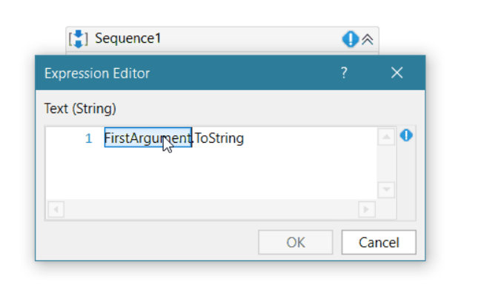
From Expressions
Alternatively, arguments can be created from expressions directly in an activity input field or the Expression Editor:
Select a part of the expression and press Ctrl+M or Ctrl+Shift+M. The Set Arg field is displayed.
Fill in the name and press Enter. The argument is created. Check its type and direction in the Arguments panel.

Slide 17
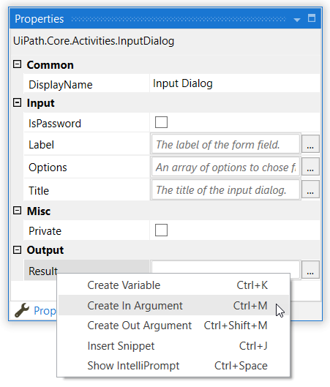
From the Properties Panel
In the Properties panel of any activity, right-click a field that can be edited, and select Create In Argument or Create Out Argument from the context menu. Alternatively, press Ctrl+M or Ctrl+Shift+M. The Set Arg field is displayed.
Fill in the name and press Enter. The argument is created and visible in the field. Check its direction and type in the Arguments panel.

Slide 18
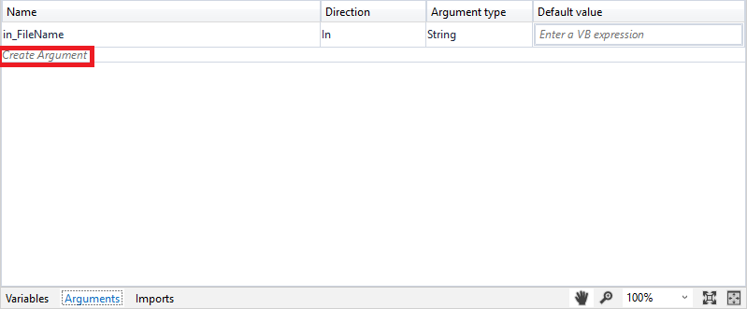
From the Arguments Panel
In the Designer panel, click Arguments. The Arguments panel is displayed.
Click the Create Argument line, and fill in the name. A new argument is created.

Slide 19
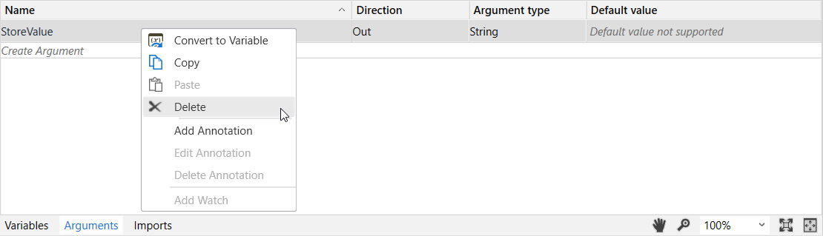
Removing Arguments
To remove an argument, in the Arguments panel, either right-click the argument and select Delete, or select the argument and press the Delete key.

